Slide 1
CHRISTMAS IN LATVIA

Slide 2
The Christmas Event at school was started by taking part of dwarfs

Slide 3
Each class sang one song

Slide 4
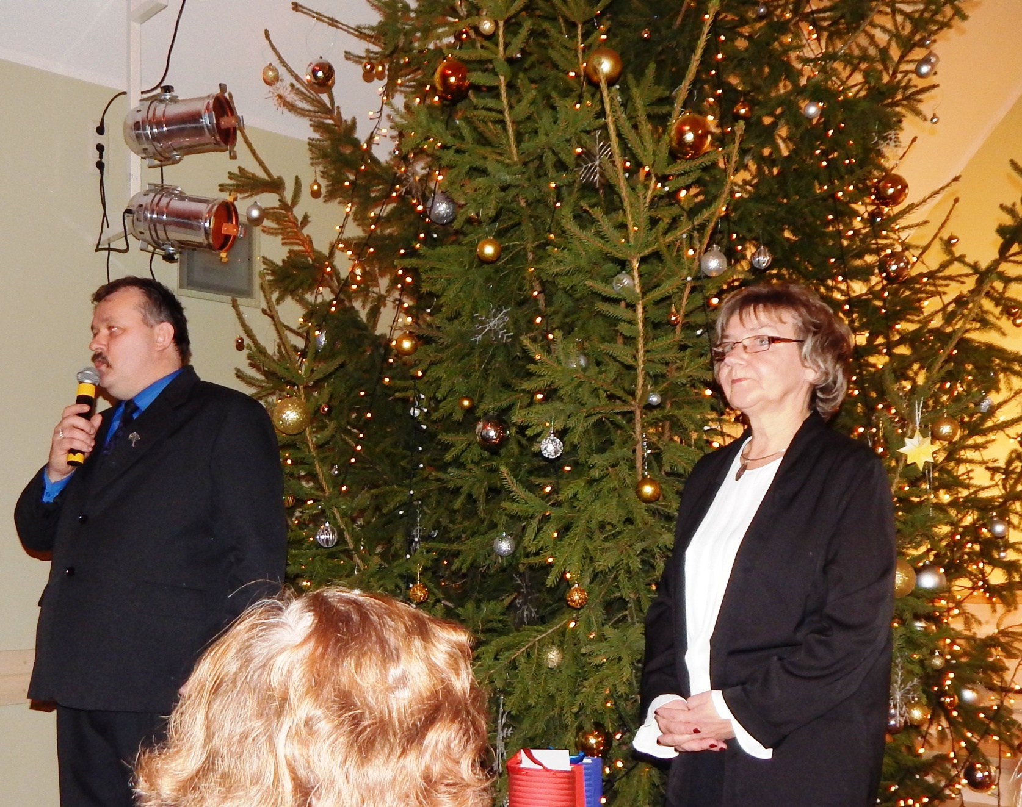
The Head and Deputy of school congratulated everyone

Slide 5
Our teacher gifts to us with our initials on gingerbread hearts

Slide 6
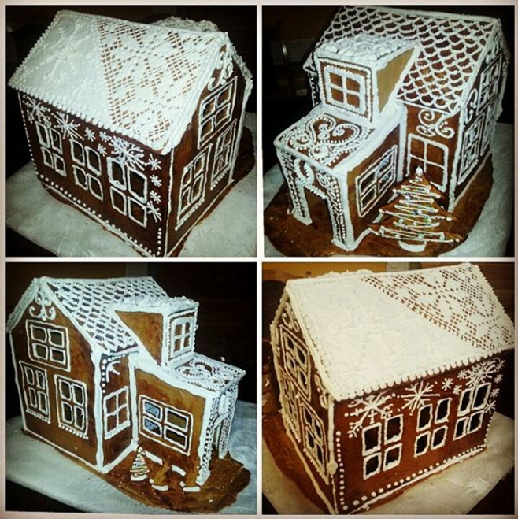
Baking gingerbreads for Christmas is one of the traditions too

Slide 7
We have Christmas Service in the Church where we go as well

Slide 8
Christmas dinner at home

Slide 11
Fire works before the beginnig of New Year

